Slide 1
Subjective Answer Finder
NLP based Information retrieval and summarization
- Viral Doshi

Slide 2
Objective
Keyword Extraction to get keywords which best define the document
Summarization to generate paragraph-wise Summaries of the document
Creating a NLP model which generates automatic subjective answers using Information Retrieval and Summarization techniques

Slide 3
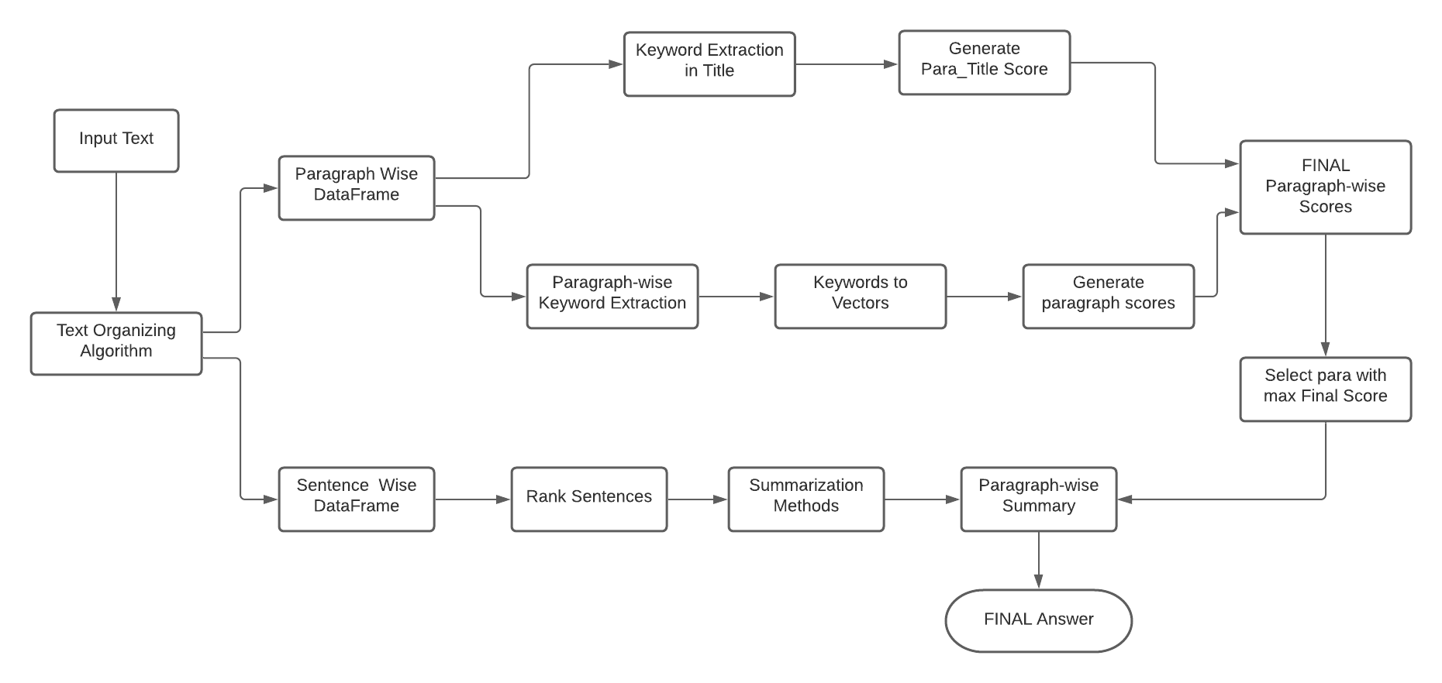
Model Architecture

Slide 4
Methodology and Work-flow
Step 1: Raw Text Data to Organized DataFrame
Step 2: Paragraph-wise Keyword Extraction
Step 3: Vectorizing Keywords to form Representative Vectors for paragraphs
Step 4: Summarizing Paragraphs to generate fixed length Answers
Step 5: Query Question to Vector
Step 6: Scoring Function to calculate Paragraph Scores
Step 7: Selecting Best Answer based on Final Scores

Slide 5
Raw Text Data to Organized DataFrame
Paragraph-wise DataFrame :
Converting the raw text to paragraph-wise data
Extracting the paragraph titles with proper content
Each Row of DataFrame : [‘Chapter_name’ , ‘Para_title’ , ‘Description’]
Sentence-wise DataFrame :
Converting the raw text to sentence-wise data
Parse the data sentence wise and store it with appropriate titles
Each Row of DataFrame : [‘Chapter_name’ , ‘Para_title’ , ‘Sentence’]

Slide 6
Paragraph-wise Keyword Extraction
Remove Punctuation from each row of paragraph-wise dataframe.
Paragraph Wise keyword Extraction using 6 different Methods.
Spacy
Yake
Gensim
RakeNLTK
Keybert-distilbert ( BERT Embedding Based )
Keybert-paraphrase (Sentence Transformer)
Lemmatizing the extracted keywords

Slide 7
Vectorizing Keywords
Converting the extracted Keywords to 100-D Vectors using Word2Vec
Word2vec uses CBOW which accounts for statistical measures like TF-IDF and Skip-Gram which uses forward prediction
Find mean Vector of this keywords and make it the representative Vector of the corresponding paragraph

Slide 8
Summarizing Paragraphs
Using the sentence wise DataFrame to generate summaries of each paragraph by ranking the sentences withtin them using 5 different Methods.
Custom Summarizer
Gensim Summarizer
Lexrank Summarizer
Luhn Summarizer
LSA Summarizer

Slide 9
Query Question to Vector
Keyword Extraction from Question
Vectorizing Keywords to form Vectors
Forming 100-D representative Vector for Query Question

Slide 10
Calculating Paragraph Score
Paragraph_Content_Score
Using Cosine Similarity between paragraph vectors and Question Vectors to generate paragraph_content_score.
Content Scores are normalized between 0 - 1
Paragraph_Title_Score
Comparing the title with extracted keywords of the Question.
Title Scores are normalized between 0 – 1
Final Score
Sum of Content Score and Title Score to get Final Scores for each paragraph.

Slide 11
Final Answer Selection
Select Paragraph with maximum Final Score
Choose a summarization method to summarize paragraph with highest Final Score
This is the required Final Answer

Slide 12
Conclusion
This method can be used effectively for Information Retrieval purposes for obtaining relevant information from big text documents
This Auto-Answering Model can also be used to find answers to given Questions from Textbooks
Many NLP based tasks such as Keyword Extraction, Vectorization and Summarization are performed which has many individual applications

Slide 13
THANK YOU !!!

